Slide 1
Apollo Global Management
Group 12 : Eddie Fu, Xinyang Gao, QiLong Yu, Pinrui Su

Slide 2
Outline
01
BACKGROUND
03
Methodology
Application Context
Application Accomplishments
Technical Steps
Data Source Combined
Conclusion from Analysis
02
Data Sources
04
Demo
Data Source Used
Data Source Structure

Slide 3
01
Background

Slide 4
Application Context
The problems we want to solve:
1. Automated financial report analysis.
2. Text preprocessing and cleaning.
3. Keyword and context extraction.
4. Sentiment analysis and quantitative evaluation.
5. Cross-year comparative analysis.
Our design and analysis are mainly used in the following scenarios:
Investor decision support: Investment institutions or individual investors can use these analysis results to judge the company's attitude and trends in risk management, profitability, asset management scale (AUM), etc., so as to make more informed investment decisions.
Internal management of the company: The company itself can use text analysis to examine the expression of risk factors and whether it needs to strengthen disclosure or improve risk control.
Supervision and compliance: Regulators or audit departments can also use such analysis methods to quickly screen for major omissions, potential fraud risks, etc.

Slide 5
Application Accomplishments
The main achievements of the project are:
Complete the automated processing from PDF to data: Build a 10K text processing system, successfully read and parse different chapters of 10-K, automatically extract key content (such as "Item 1A. Risk Factors"), and lay the foundation for subsequent sentiment analysis.
Build a keyword sentiment analysis model: Use tools such as VADER to score keywords (risk, investment, income, AUM) and output quantifiable positive and negative indexes.Compare the analysis results.
Popularize and visualize the results: Use visualization or tables to show the differences in risk and return between 2023 and 2024, providing reference for subsequent strategic or investment decisions. And convert the analysis content into digital comparison to increase comparability.

Slide 6
02
Data Sources

Slide 7
Data Source Used
Primary Source: Apollo’s 10-K Filings in 2023 & 2024
What are 10-K Filings? Why Apollo’s 10-Ks?
Annual reports required by the U.S. Securities and Exchange Commission (SEC) for publicly traded companies
Offer insights into its risk management practices, investment strategies, and growth targets
Key Sections Analyzed:
Item 1A (Risk Factors): Outlines the key risks Apollo faces
Item 7 (Management’s Discussion): provides insights into Apollo’s strategic priorities, growth targets & financial performance.
Extraction Method:
Regex-based page-range detection for precision
Isolate growth-related clauses and strategic themes.

Slide 8
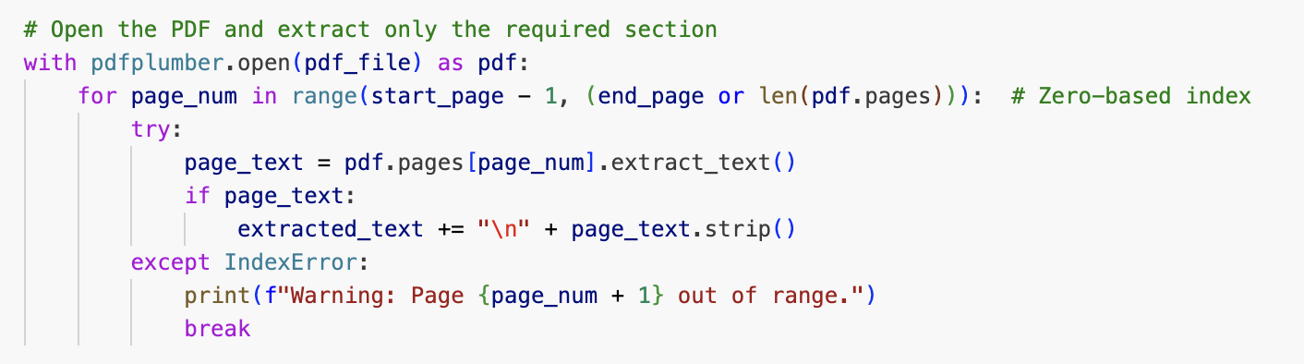
Data Source Structures
Apollo’s 10-K Filings
Format
Unstructured PDFs
converted into structured text using “pdfplumber”
Key Fields:
Risk Factors: Extracted from Item 1A.
Growth Targets: Extracted from Item 7.
Challenges:
Text Complexity: Legal and financial jargon can complicate parsing.
Volume: 10-K filings are lengthy (often 200+ pages), requiring efficient text extraction methods

Slide 9
03
Methodology

Slide 10
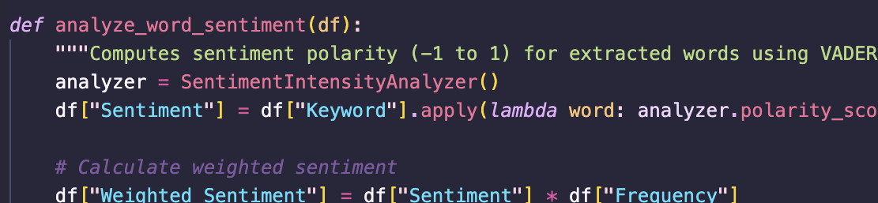
Technical Steps
Download SpaCy, Pandas, and vaderSentiment and NLTK with the libraries (i.e. en_core_web_sm, pdfplumber, sent_tokenize) and the 10k for Apollo for 2023 and 2024
Extract the items needed by parsing through the different section items
From the extracted section, extract specific words within the section by preprocessing the words and using vaderSentiment to analyze frequency of words and intensity
After analyzing the sentiment, compare the scores from 2023 and 2024 based on the specifications

Slide 11
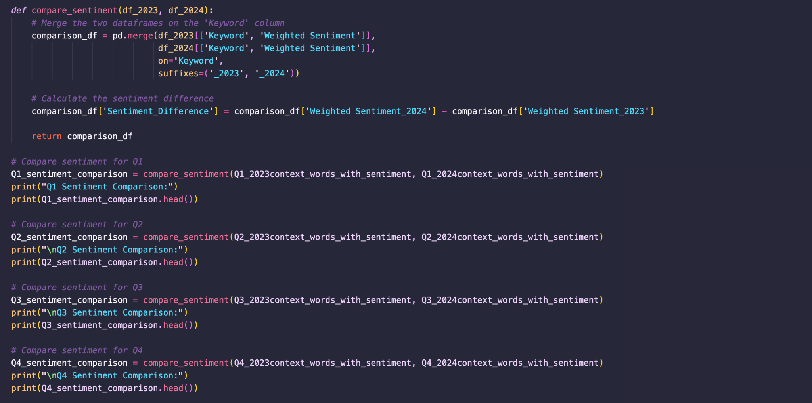
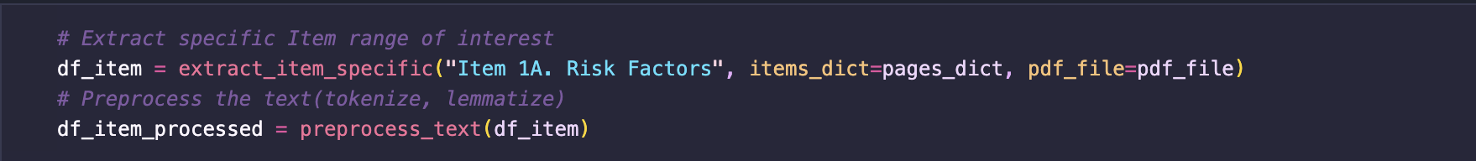
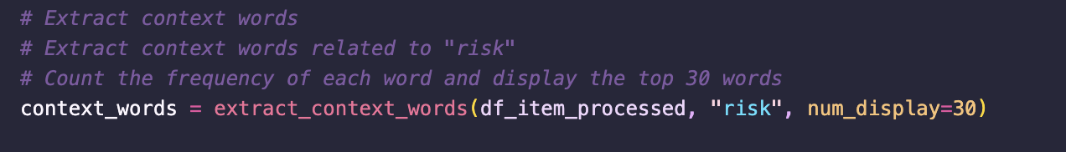
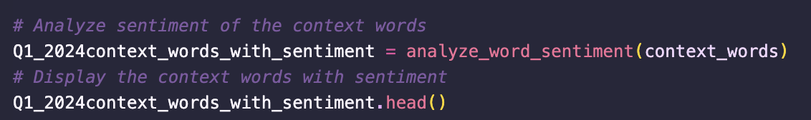
Data Source Combined
We combined 10k from 2023 and 10k from 2024 to compare and analyze risk factors and chance of profitability between the two years

Slide 12
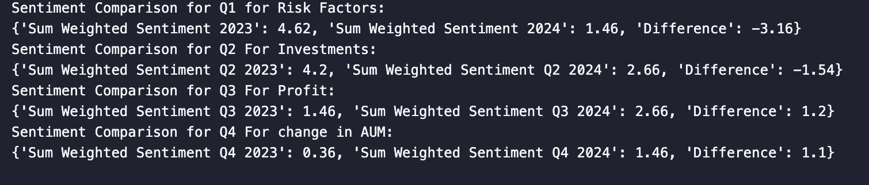
Conclusion From Analysis
Apollo Global Management has a generally positive forward looking outlook from our analysis of their 10k
2024 was a less risky year compared to 2023
2023 was a better year for investments compared to 2024 (post-pandemic recovery)
2024 was a better year for total profits compared to 2023
2024 was a better year for total assets compared to 2023

Slide 13
04
Demo

Slide 14
Uses Cases
Q1.How it has changed from 2023-2024 (Risk Factors more or less and to what degree)
Key word: “risk”
Range: Item 1A. Risk Factors
Year: 2023/2024
Q2. Investments (where are they investing the money)
Key word: “investment”
Range: Item 1. Business
Year: 2023/2024

Slide 15
Uses Cases
Q3. Value Generation (How it is making Money)
Key word: "income"
Range: Item 7. Management's Discussion and Analysis of Financial Condition and Results of Operations
Year: 2023/2024
Q4. Total AUM (Assets under management) change from 2023-2024
i. Basic analysis of balance sheet between 2023 and 2024 and AUM delta
Keyword: “AUM”
Range: Item 7. Management's Discussion and Analysis of Financial Condition and Results of Operations
Year: 2023/2024
Q5. Sentiment Analysis (Change in total Score from 2023 to 2024)

Slide 16
THANK YOU
Group 12

